Slide 1
Discrete Mathematics
South China University of Technology
1

Slide 2
Chapter 10. Trees
Minimum Spanning Trees
Section 10.5
2

Slide 3
Example of Computer Network
$2000
D
E
$1000
$1200
$1300
$1600
$800
$900
A
$700
$1400
B
$2200
C
We can solve the problem by finding a spanning tree so that the sum of weights of the edges of the tree is minimized. Such a spanning tree is called a minimum spanning tree.

Slide 4
Minimum Spanning Trees
Definition 1 : A minimum spanning tree in a connected weighted graph is a spanning tree that has the smallest possible sum of weights of its edges.
There are two algorithms for building the minimum spanning trees.
1. Prim’s Algorithm
2. Kruskal’s Algorithm

Slide 5
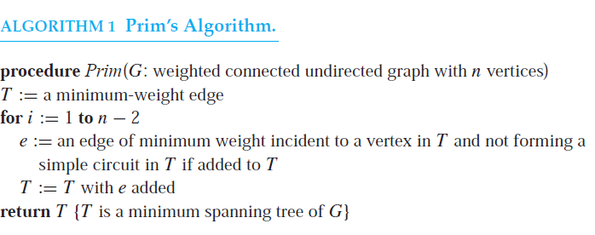
Note that T always is a tree.

Slide 6
Example 1
$2000
D
E
$1000
$1200
$1300
$1600
$800
$900
A
$700
$1400
B
$2200
C
1 {C, D} $700 2 {C, E} $800
3 {D, A} $1200 4 {A, B} $900
Total : $3600

Slide 7
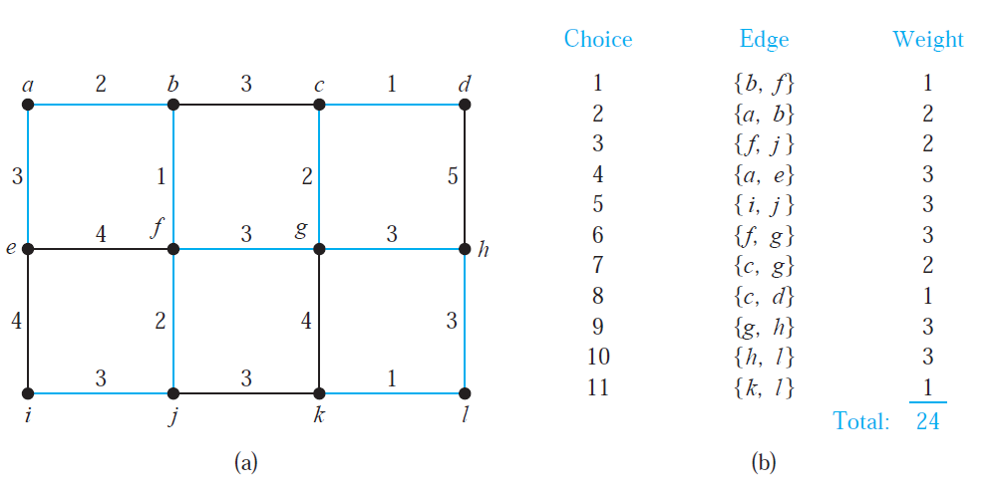

Slide 8
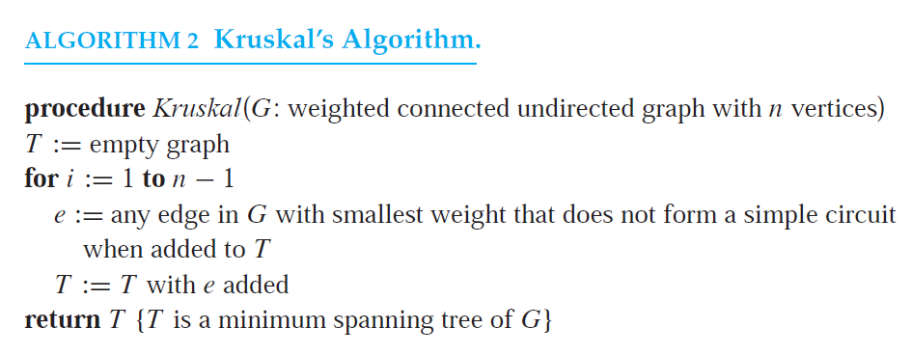
Algorithm 2 : Kruskal’s Algorithm
Note that T may be not a tree before termination.
O(e*log e)

Slide 9
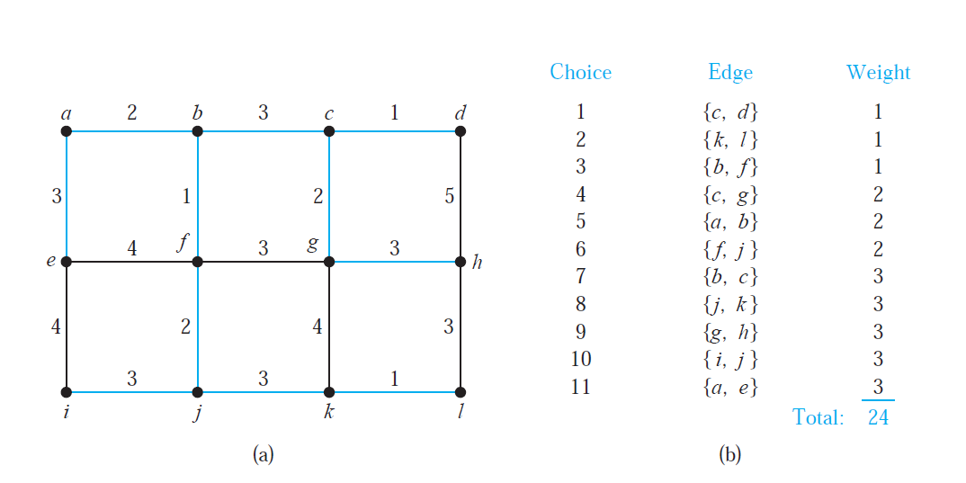

Slide 10
End of Section 10.5
Click to edit company slogan .
10

